Slide 2

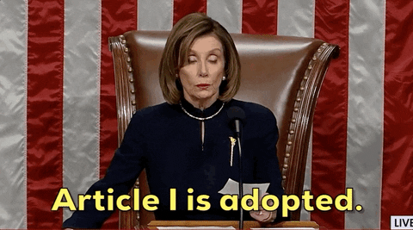
ARTICLES
A Short Presentation by
Varun Gaur
(ENROLL NO. 210410107077)

Slide 3
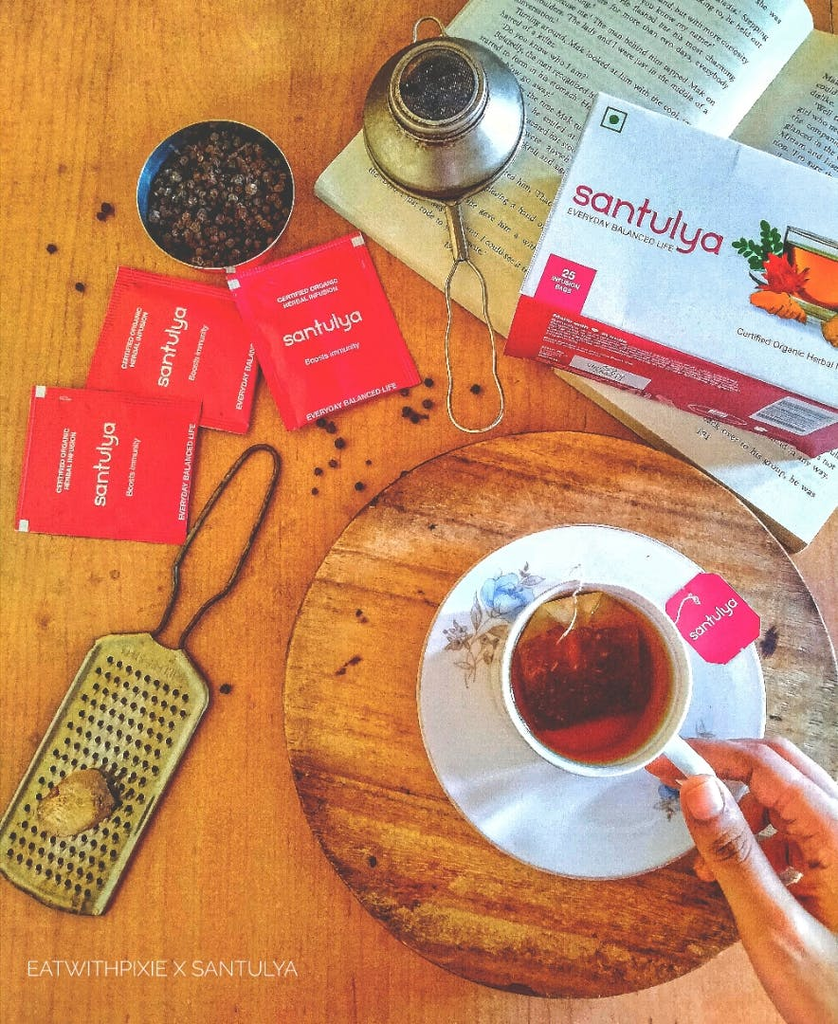
USE OF ENGLISH ARTICLES IN DAILY LIVES
The use of Articles lies behind the definition.
Articles are words that are generally points out any subject, or in total: noun.
For example
After the long day, the cup of tea tasted particularly good.
and another one
After a long day, a cup of tea tasted particularly good.

Slide 4
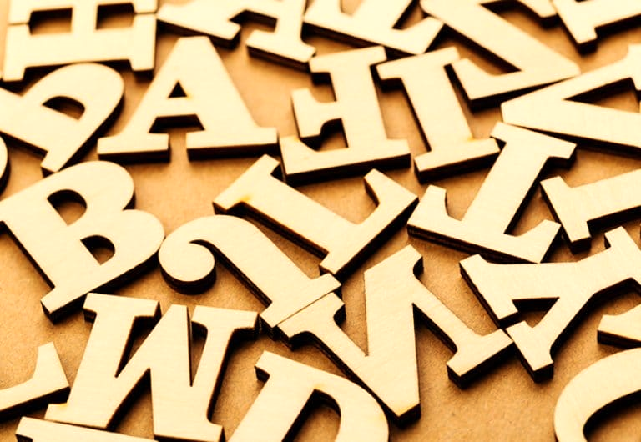
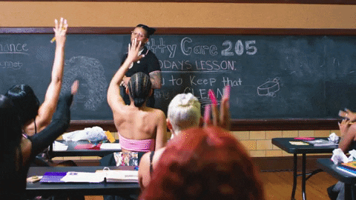
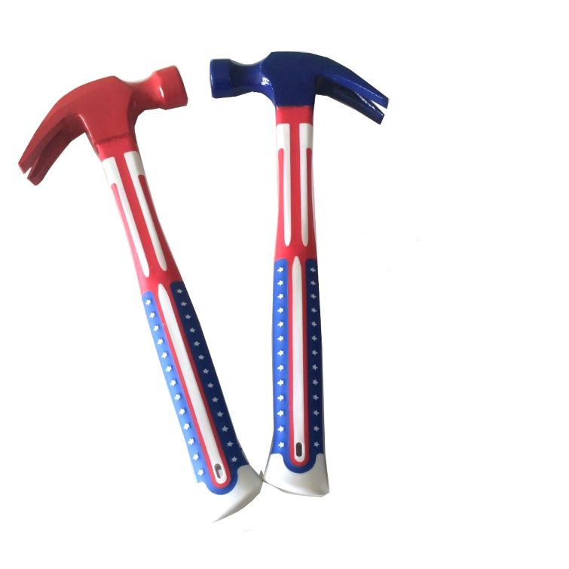
TYPES OF ARTICLES: DEFINITE ARTICLE/THE
It limits the meaning of a noun to one particular thing.
The definite article can be used with singular, plural, or uncountable nouns.
Example: Please give me the red hammer; the blue one is too small.
Example: Please give me the large nail; it’s the only one strong enough to hold this poster.
Simple Error:
I’m Best (Wrong)
I’m the Best (Right)
Article ‘The’ can be used for Adjectives for superlative degree.

Slide 5
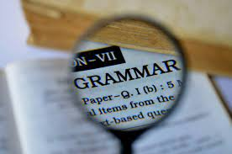

TYPES OF ARTICLES: INDEFINITE ARTICLE/ ‘A’ & ‘AN’
The indefinite article takes two forms.
It indefinite article only appears with singular nouns.
It indicates that a noun refers to a general idea rather than a particular thing.
Article ‘a’ is used when a word begins with a consonant. While ‘an’ when it begins with a vowel.
Example for ‘a’:
One day, I’ll drive a car.
Send me a message.
Example for ‘an’:
An apple was fell down from the tree.
Give me an umbrella.

Slide 6


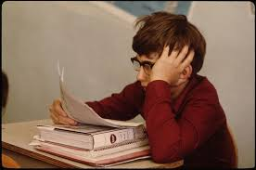
NOW THE MAIN AND IMPORTANT PART OF THIS PRESENTATION BEGINS
WHEN TO USE AND HOW TO USE ARTICLES?

Slide 7

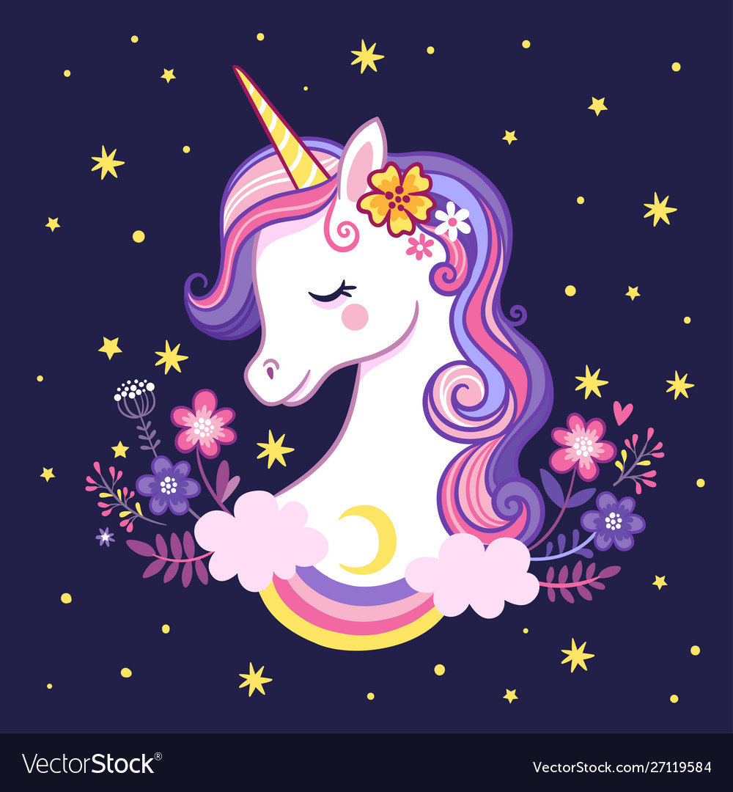
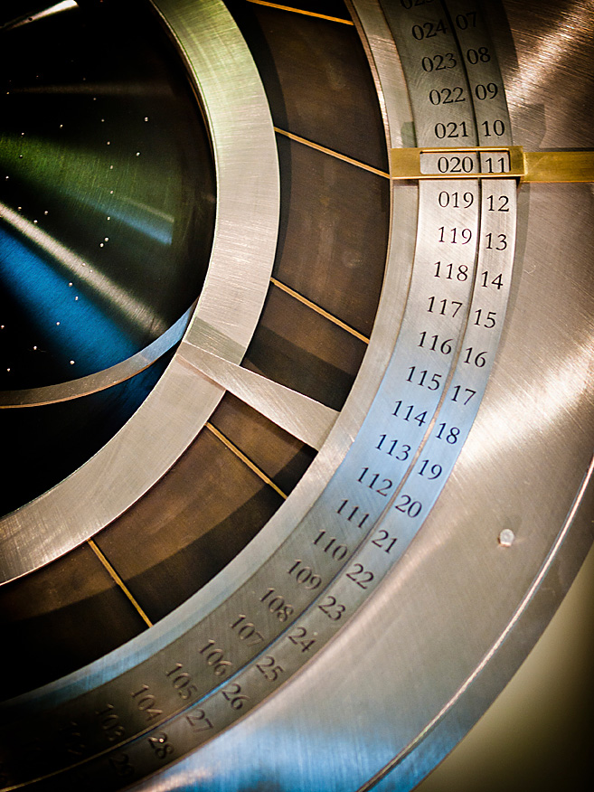

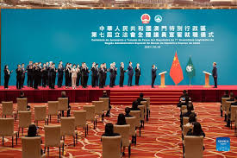
EXCEPTIONS OF WHILE USING ‘A’ AND ‘AN’
Some words begin with a consonant but when we pronounce it starts with a sound, One of the best example is….
HOUR
Example: My mother is an honest woman (Instead of ‘My mother is a honest woman)
Similarly, when the first letter of a word is a vowel but is pronounced with a consonant sound, use a.
Example: Having A Unicorn is a fairy dream (Instead of Having an Unicorn is a fairy dream
AN is also used for short form terms. Like,
An LCD
An MLA
An URL and much more……………..

Slide 8
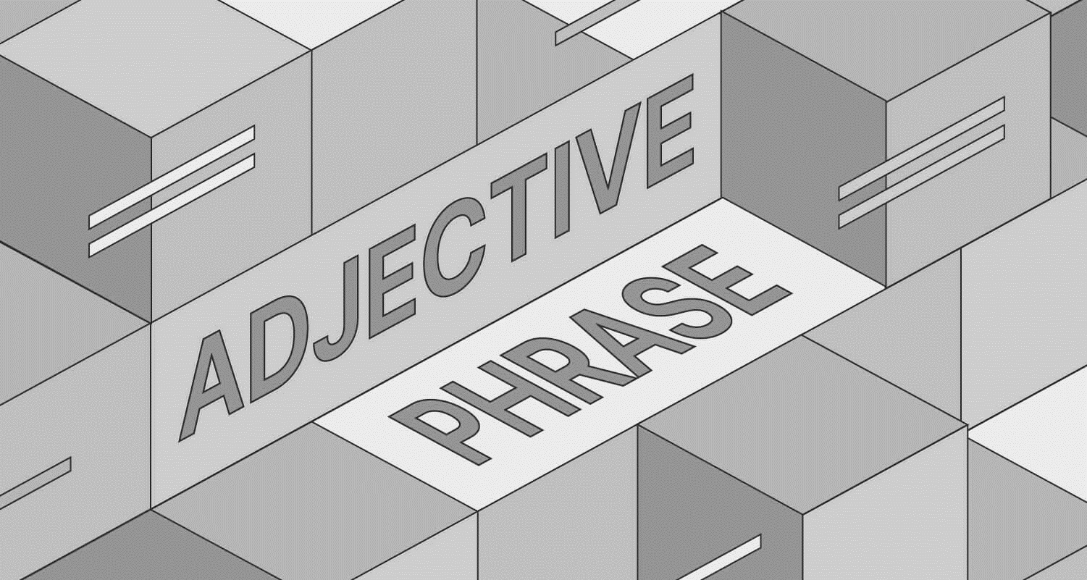
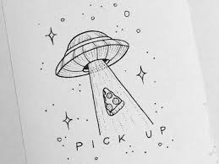
ARTTCLES WHILE USING AT ADJECTIVE
Articles are used before an adjective. While articles determine an object, adjectives add beauty which shows interests of such things.
The usual word order is article + adjective + noun.
For Example:
That was a good story.
She made an unexpected drawing.
Using of articles are also varied on the degree of adjectives used.
If the degrees remain positive or comparative, then indefinite articles are used. If and only if the degree is superlative, then definite.

Slide 9
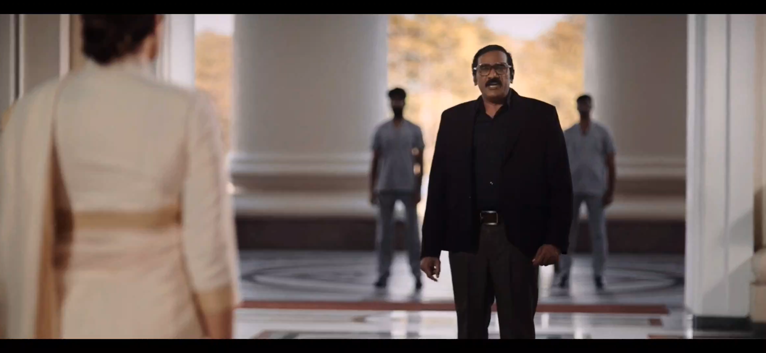

Slide 10
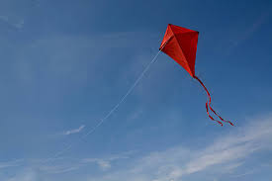


Articles on countable and uncountable nouns
Uncountable nouns include intangible things (e.g., information, air), liquids (e.g., milk, wine), and things that are too large or numerous to count (e.g., equipment, sand, wood).
Instead of Articles, words like couple, few, many, some, and etc.
For example,
If there’s only one kite: I can see a flying kite.
And if there’s many: I bought a stack of kites.
Since sand isn’t a countable noun. We cant say “I have a sand”. For that “I have a fist full of sand”
If the count of subject is one, then we can use articles.
For example: We can use articles in the following case
Give me a blank paper or
Give me some blank papers.

Slide 11

OMISSION OF ARTICLES
Sports and academic subjects do not require articles. See the sentences below for reference.
For Example,
I lost a badminton racket. (wrong)
I lost my badminton racket
Articles are omitted altogether before certain nouns. In these cases, the article is implied but not actually.
This implied article is sometimes called a “zero article.” Often, the article is omitted before nouns that refer to abstract ideas present
For Example,
Let’s go out for a dinner tonight. (wrong)
Let’s go out for dinner tonight.
.

